Slide 1
Event Sourcing
Crowd Programming

Slide 2
Conventional Data Store
Port
Ship
Name: Rotterdam
…
Name: Albatross
…
Cargo
Name: Kohle
…

Slide 3
Event Sourcing Data Store
LoadEvent
LoadEvent
DepartureEvent
ArrivalEvent
UnloadEvent
DepartureEvent
ArrivalEvent
Ship: Albatross
Cargo: Stahl
Ship: Albatross
Cargo: Kohle
Port: Basel
Ship: Albatross
Port: Hamburg
Ship: Albatross
Ship: Albatross
Cargo: Stahl
Port: Hamburg
Ship: Albatross
Port: Rotterdam
Ship: Albatross

Slide 4
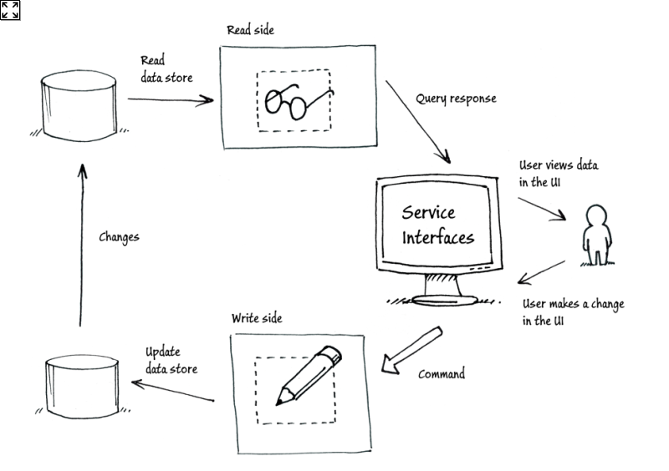
Command Query Responsibility Segregation
from Microsoft

Slide 5
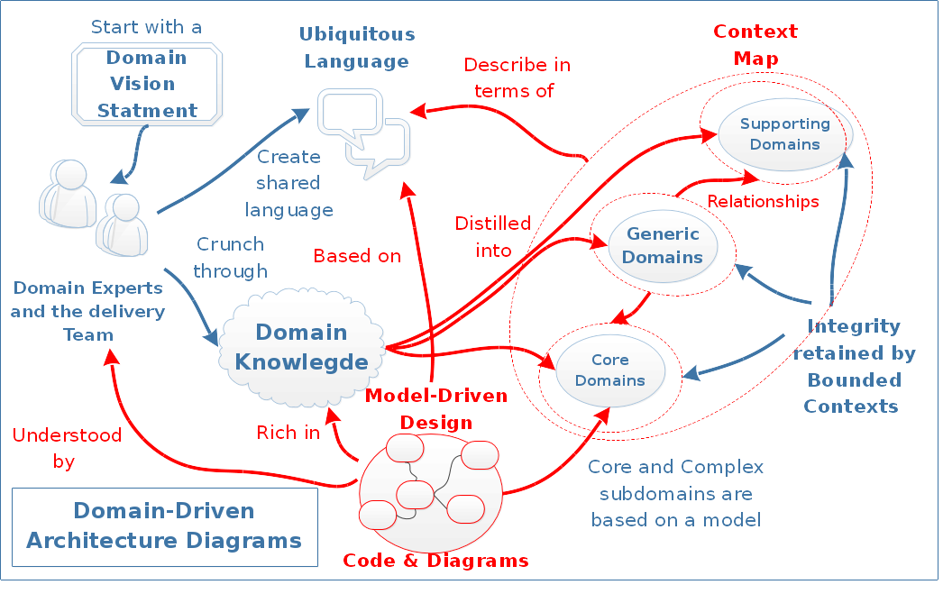
Domain Driven Design

Slide 6
Sources
Event Sourcing Blog (Martin Fowler)
CQRS and Event Sourcing Youtube Session (Greg Young)

Slide 7
Event Sourcing
Crowd Programming

Slide 8
Häfen

Slide 9
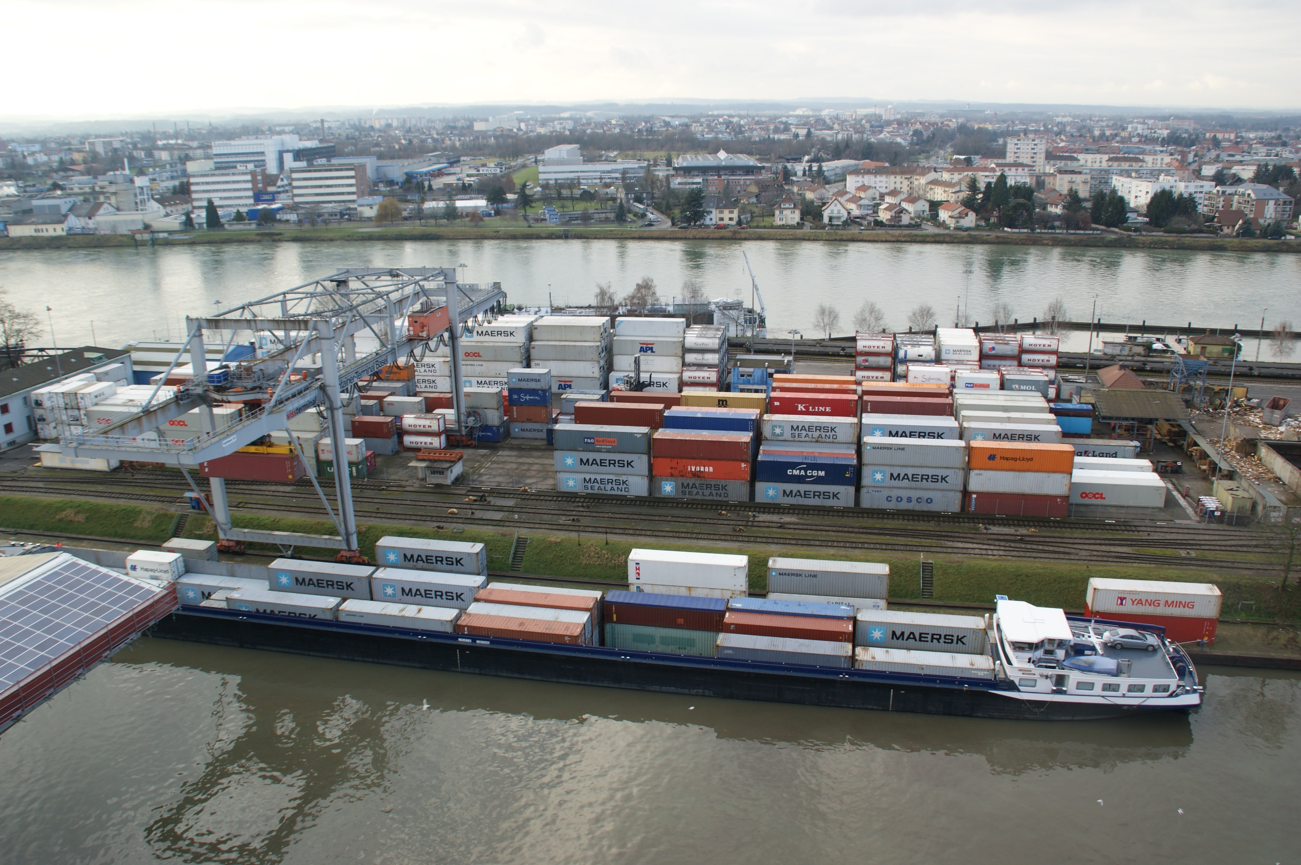

Slide 10
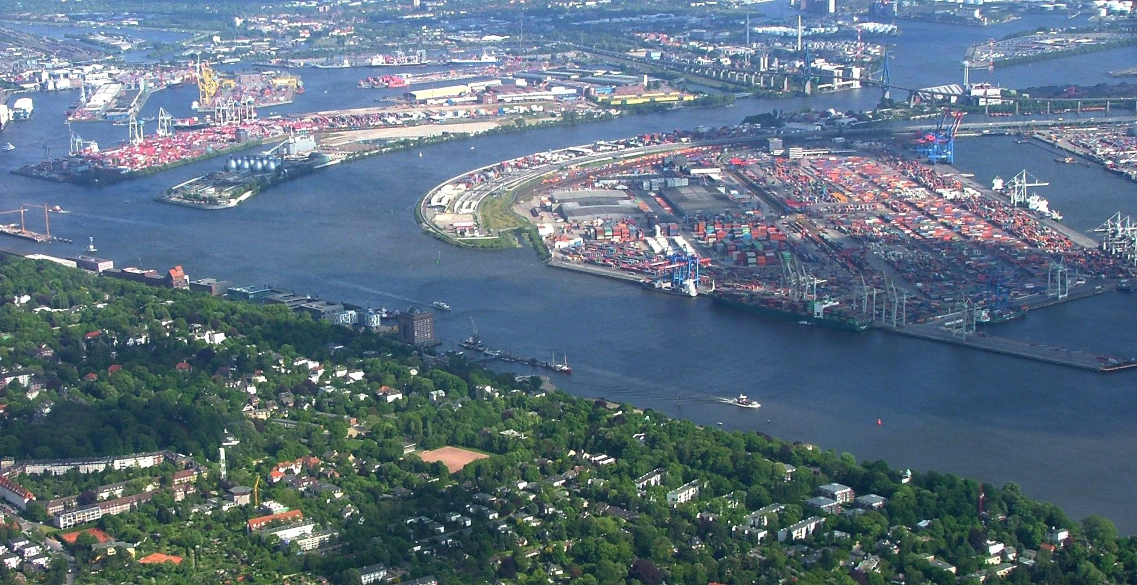

Slide 11
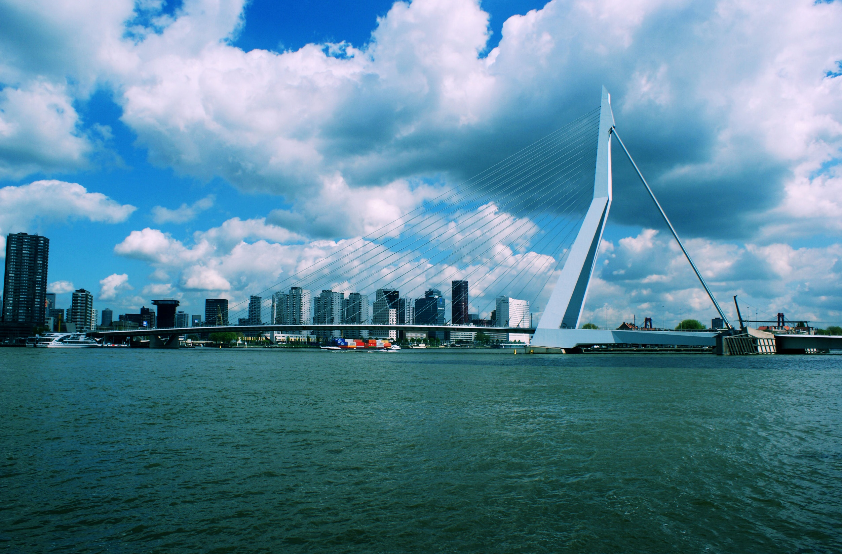

Slide 12
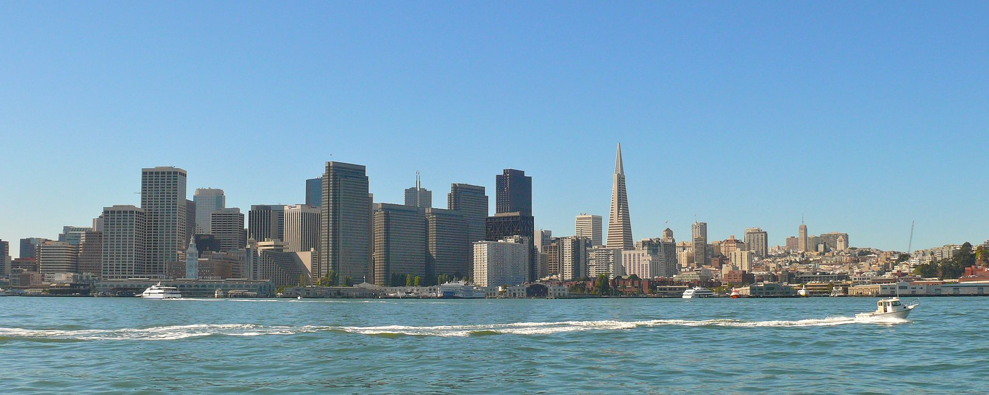

Slide 13
Schiffe

Slide 14
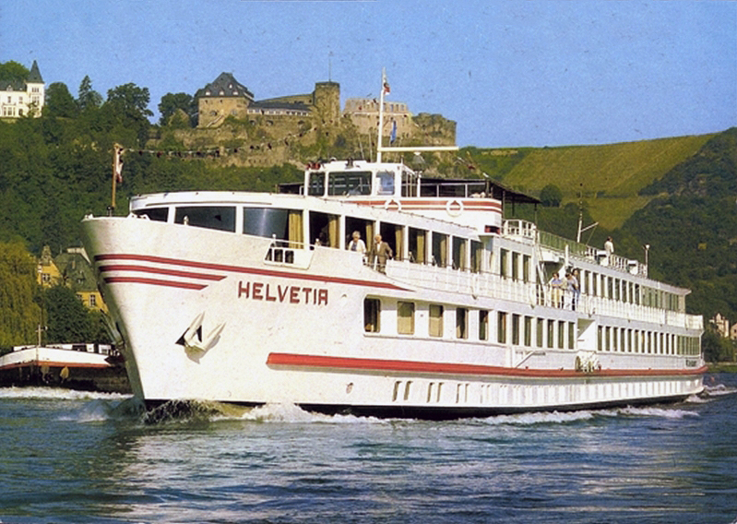

Slide 15
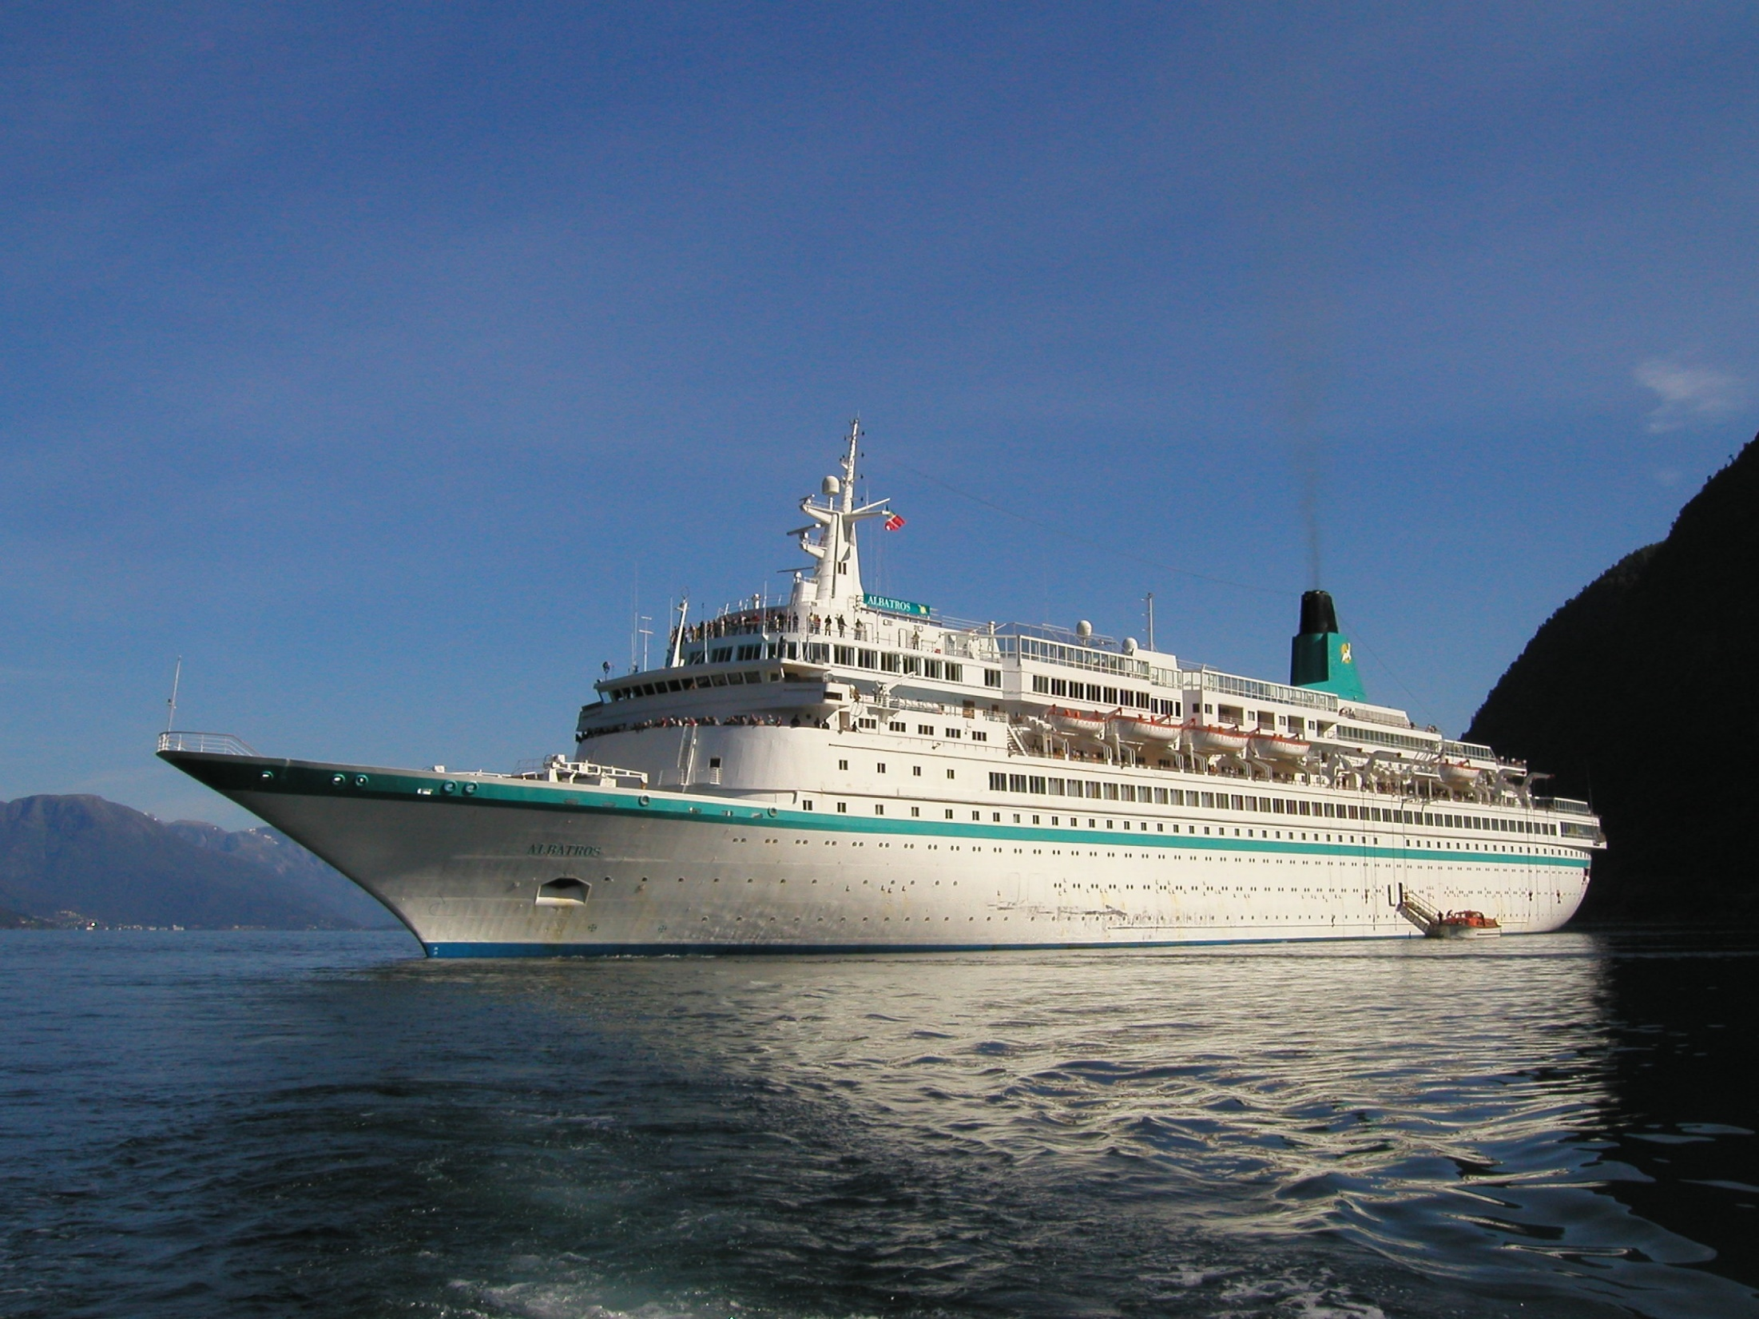

Slide 16
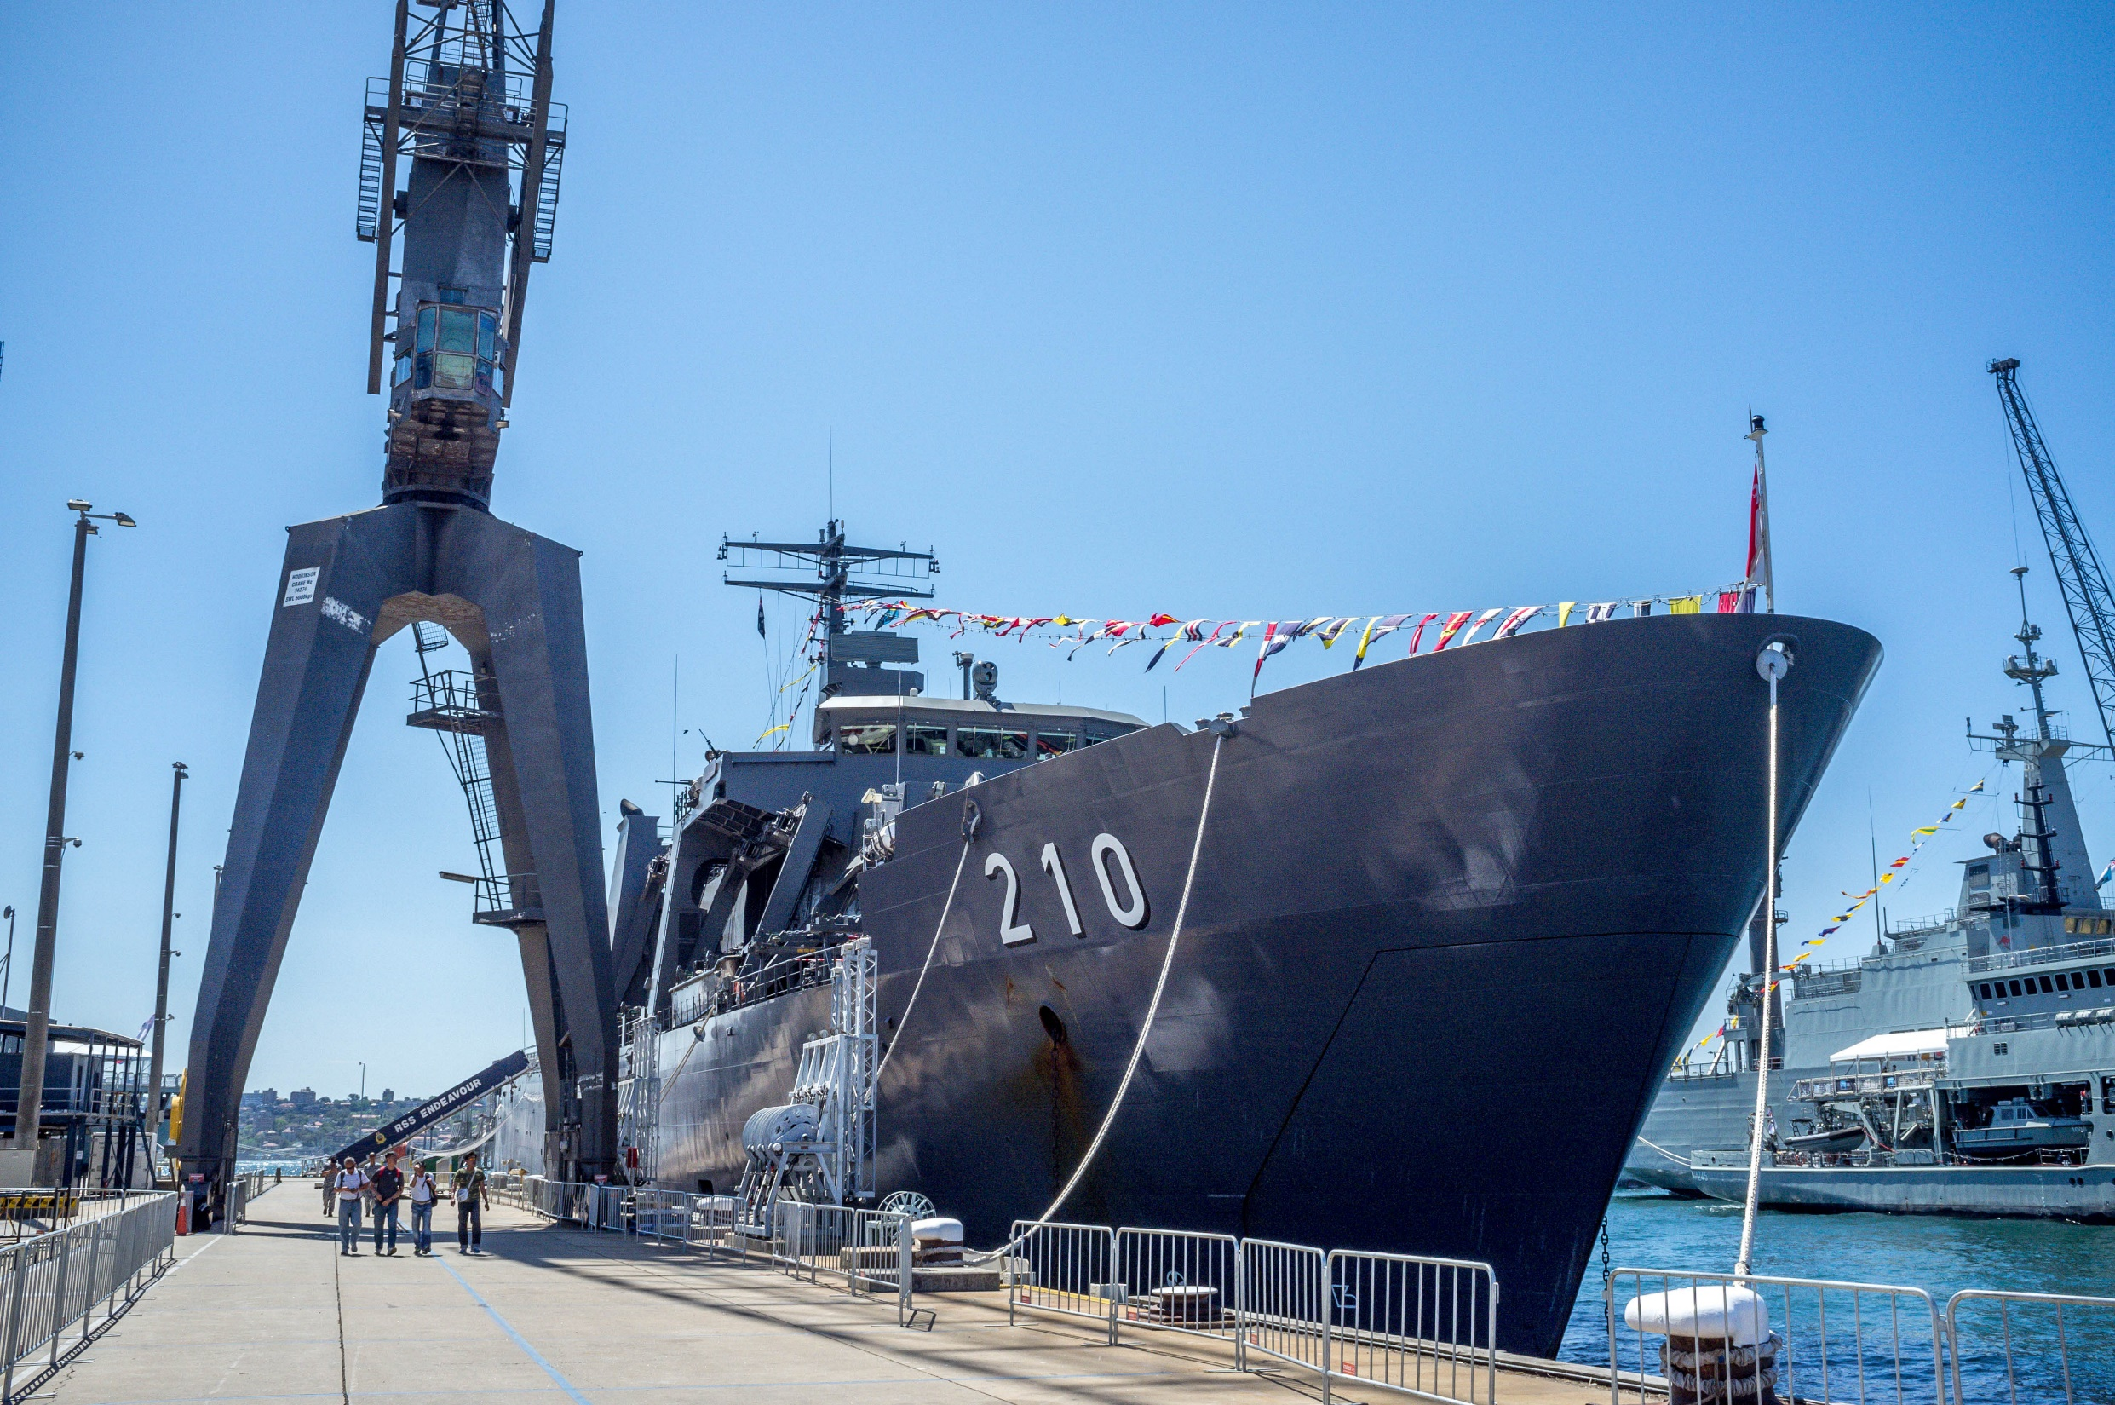

Slide 17
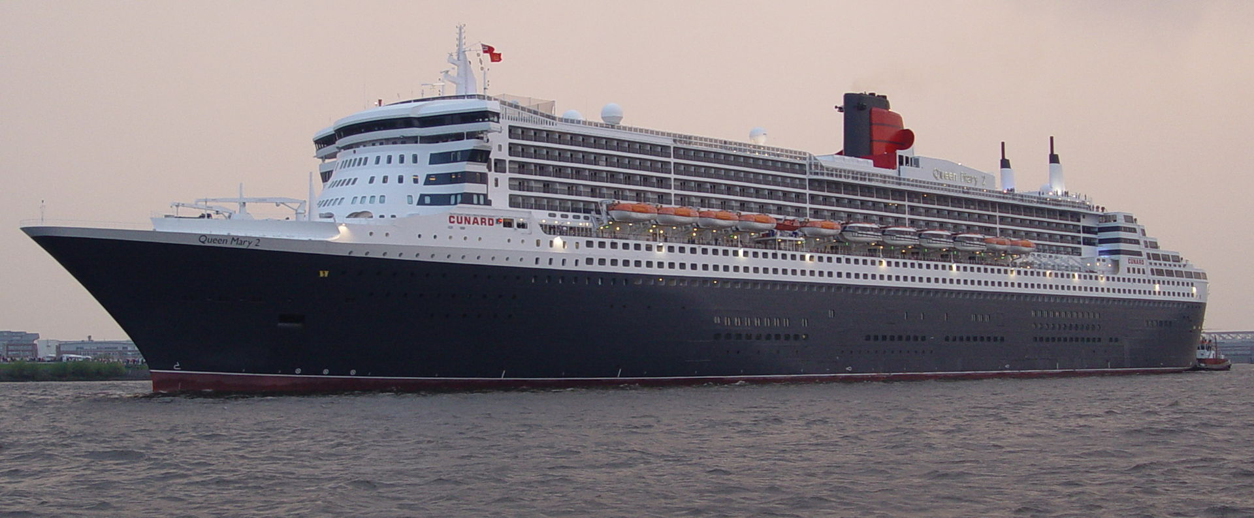

Slide 18
Fracht

Slide 19
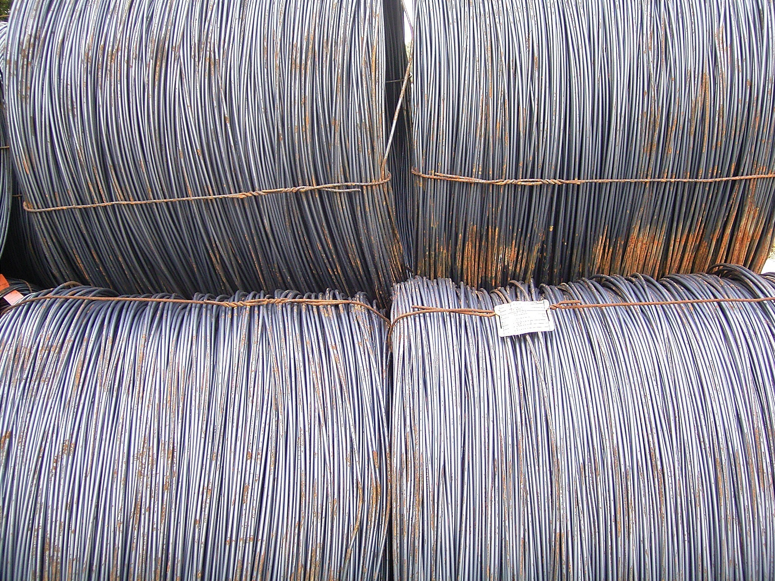

Slide 20
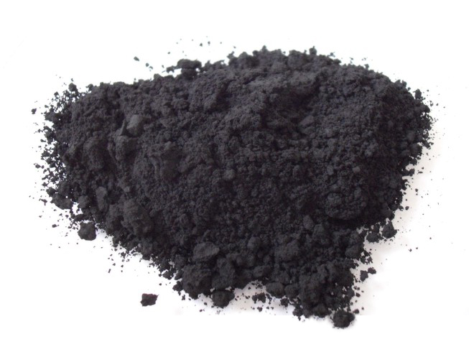

Slide 21
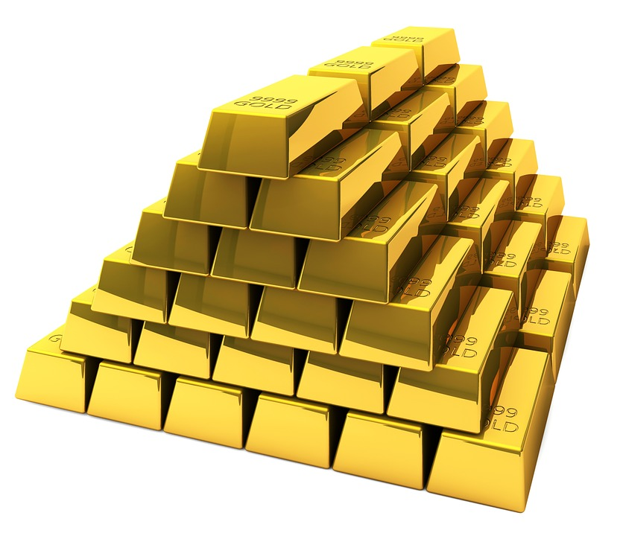

Slide 22
Ereignisse

Slide 23
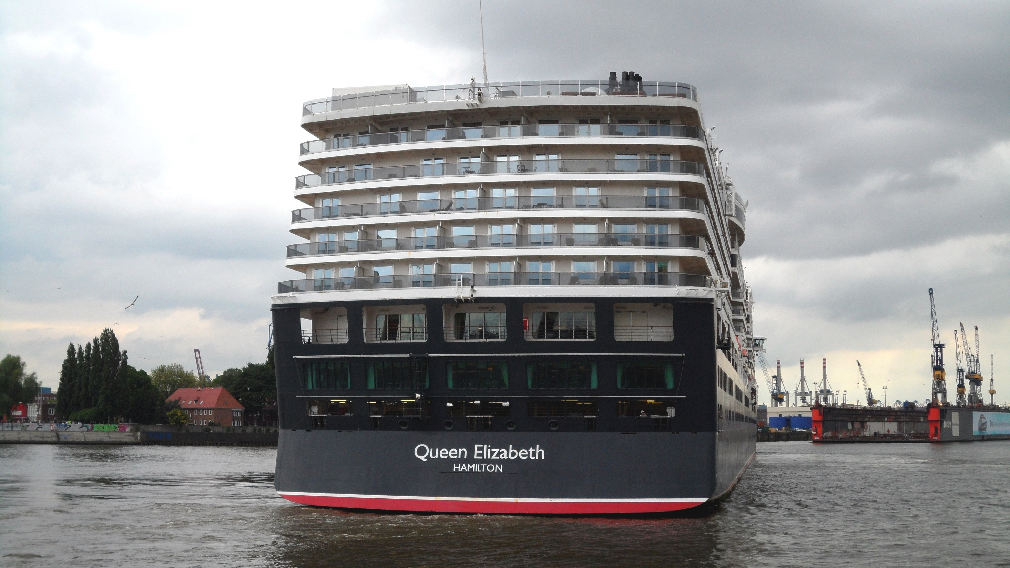

Slide 24
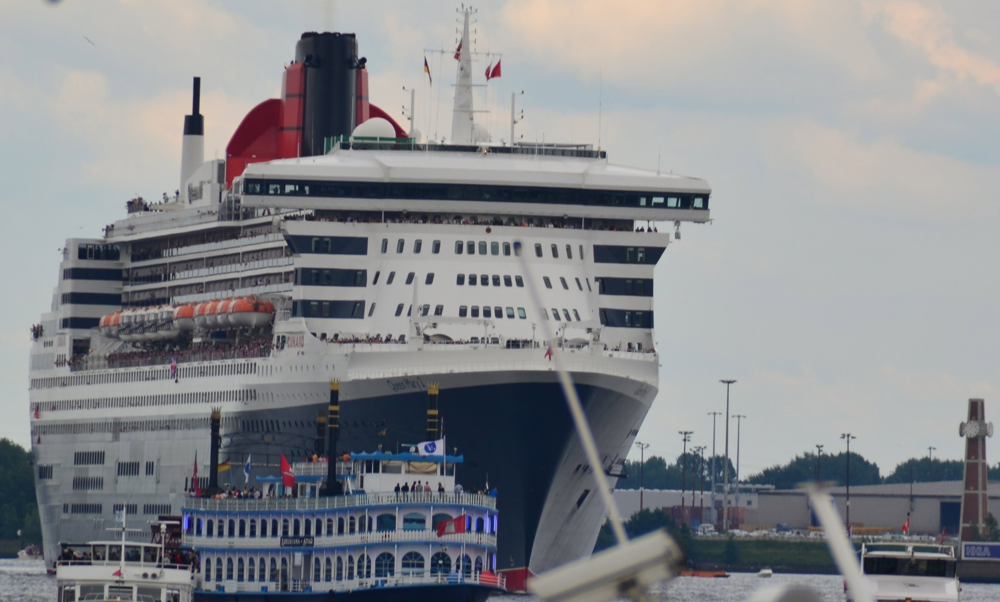

Slide 25
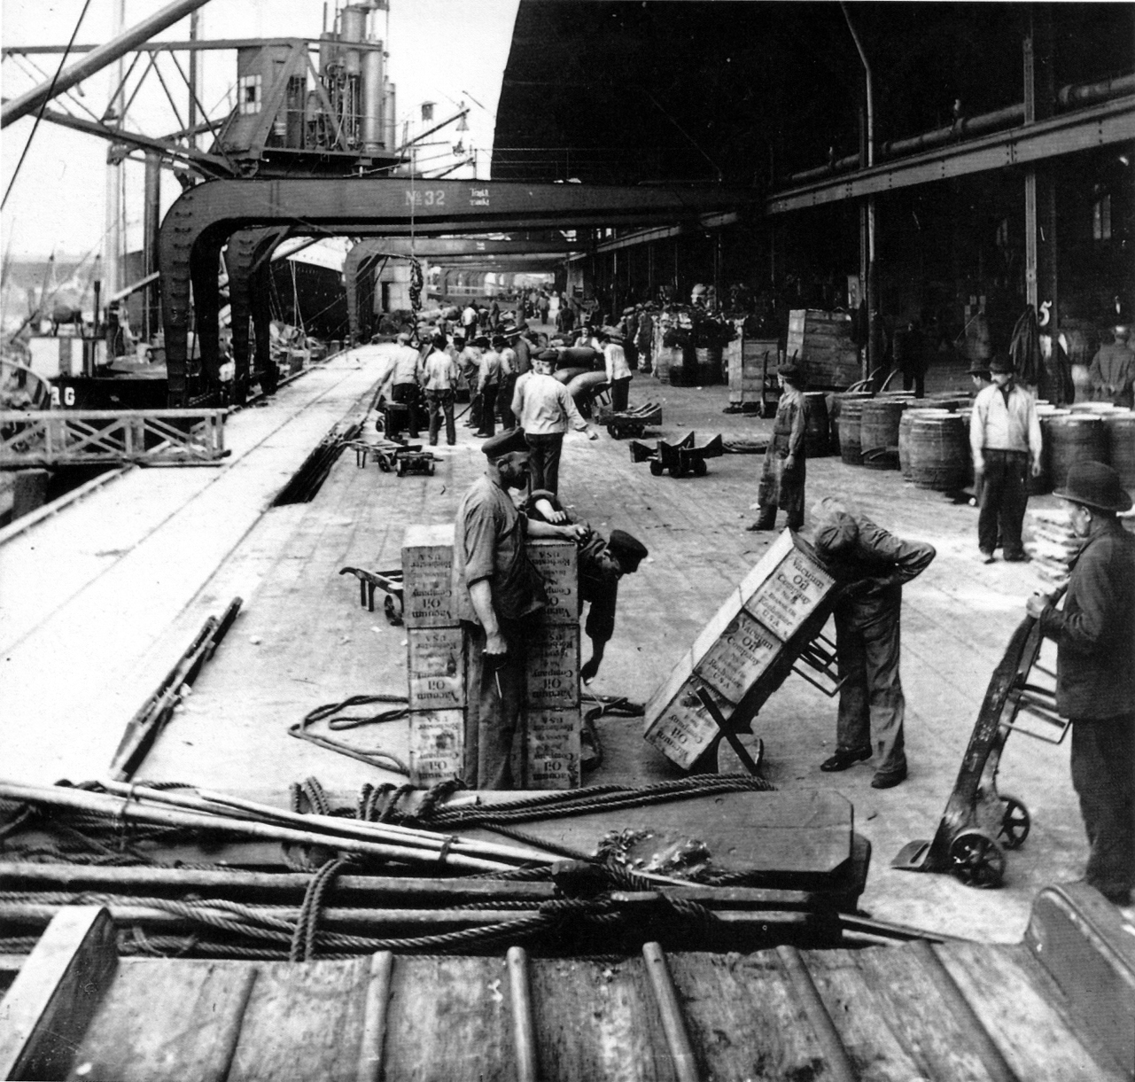

Slide 26
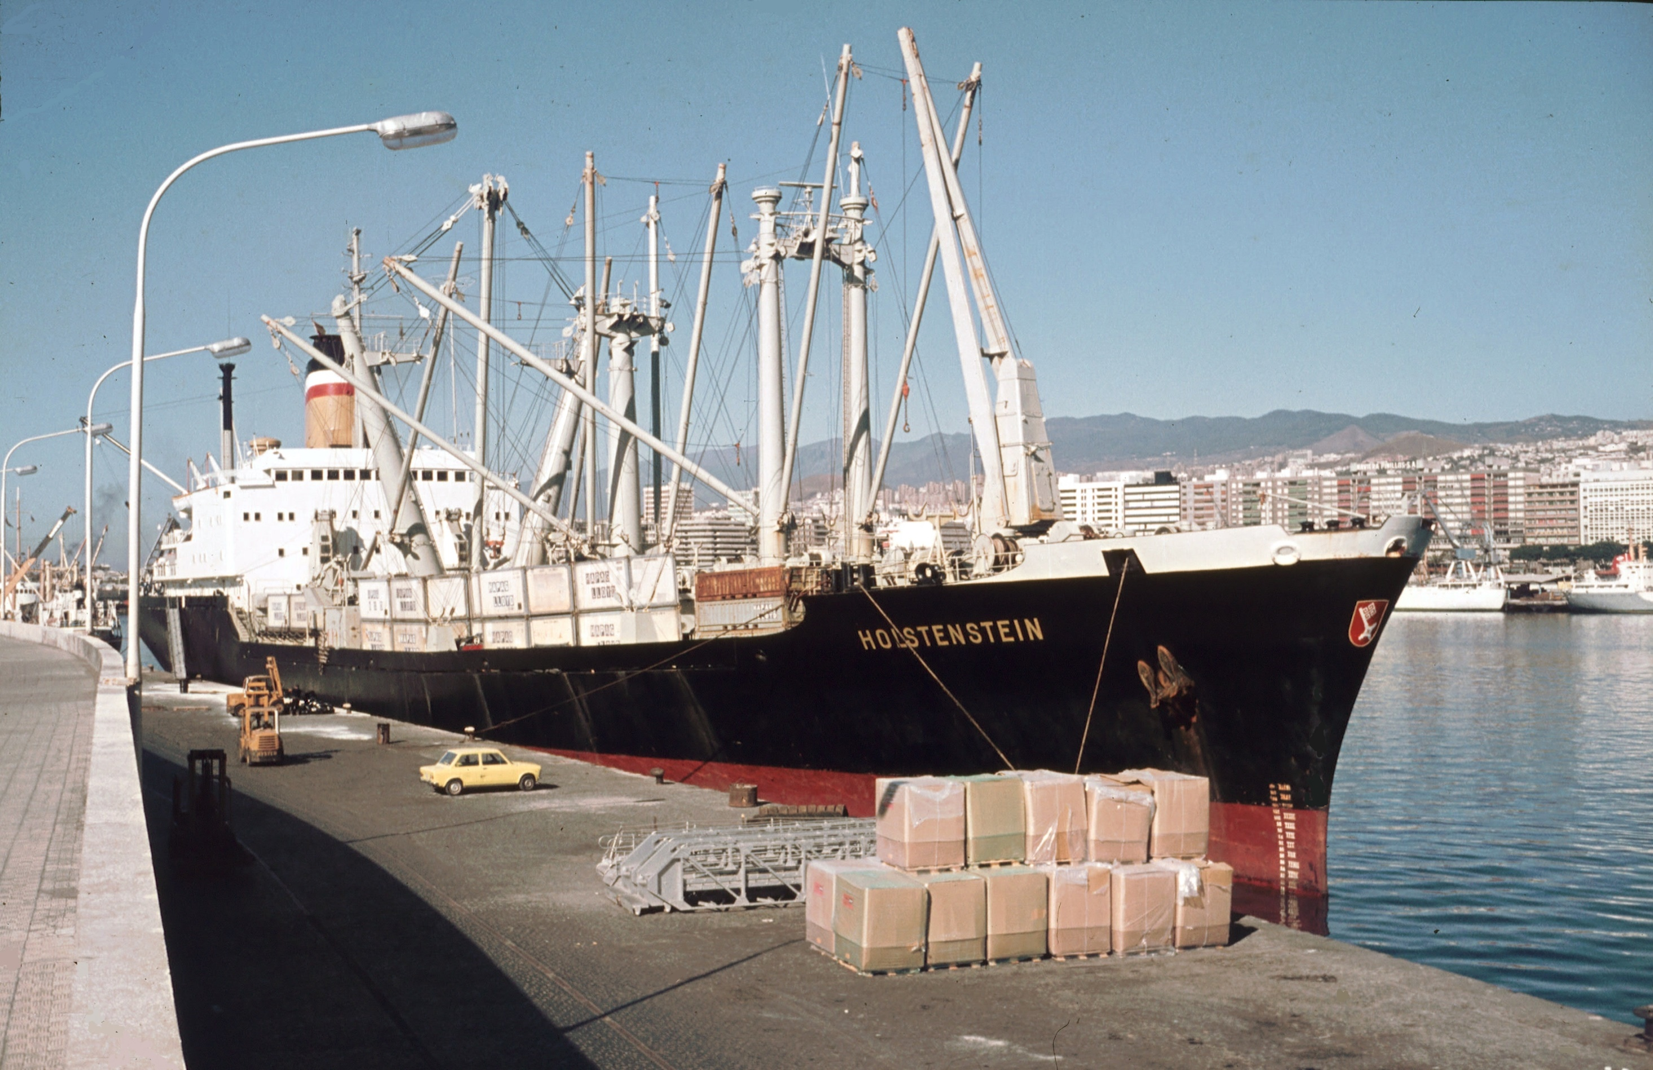

Slide 27
Aufgabe

Slide 28
